Slide 1

Remember everything.

Slide 2
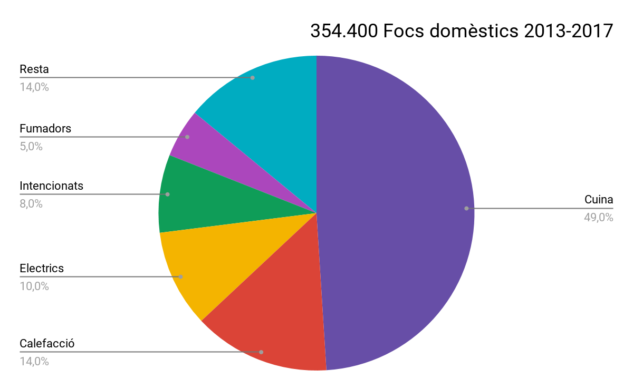

Slide 3



Slide 4



Slide 5

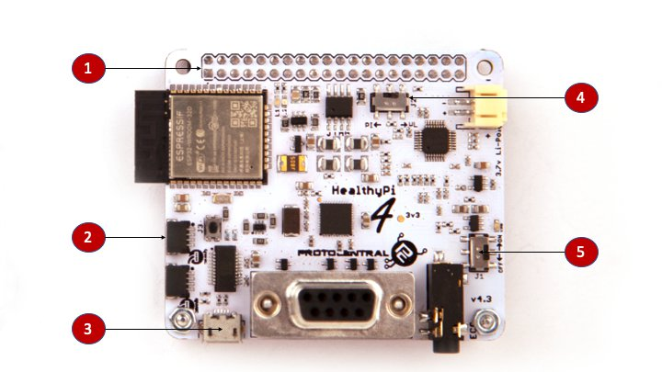
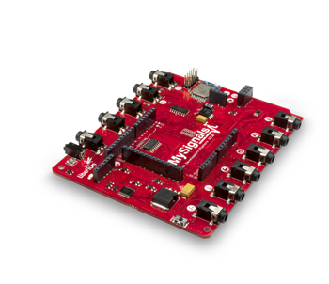
HealthyPi v4

Slide 6


Slide 7


Slide 8
BREAKING FOR
Guillem Butron
Jofre Muniesa
Edoardo Puig
Pere Soler
Moltes gràcies

